Slide 1
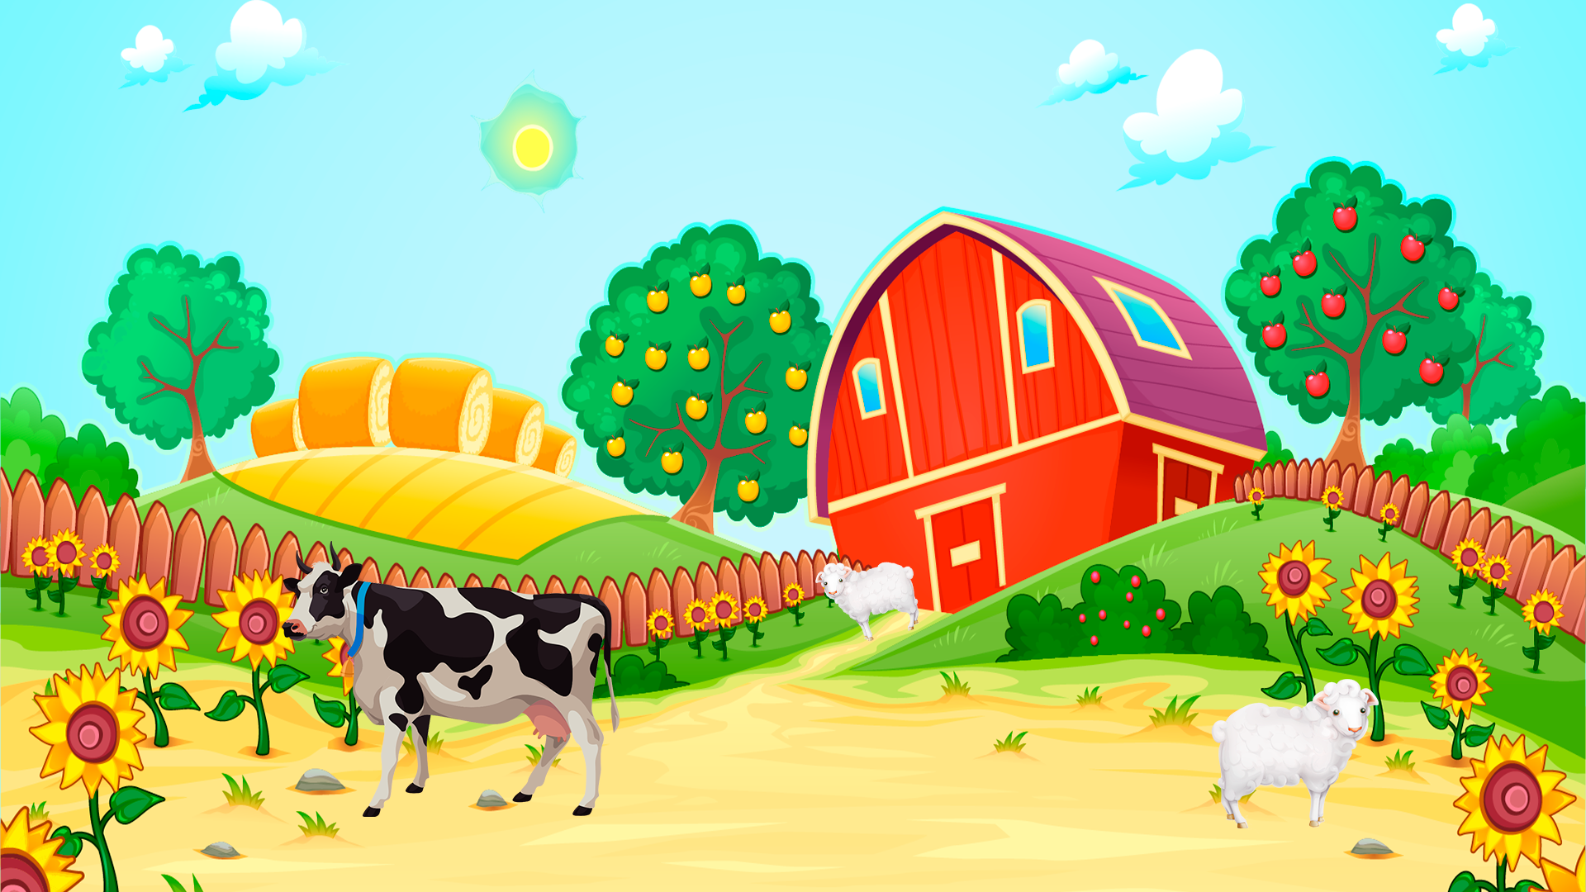




My
ABC

Slide 2


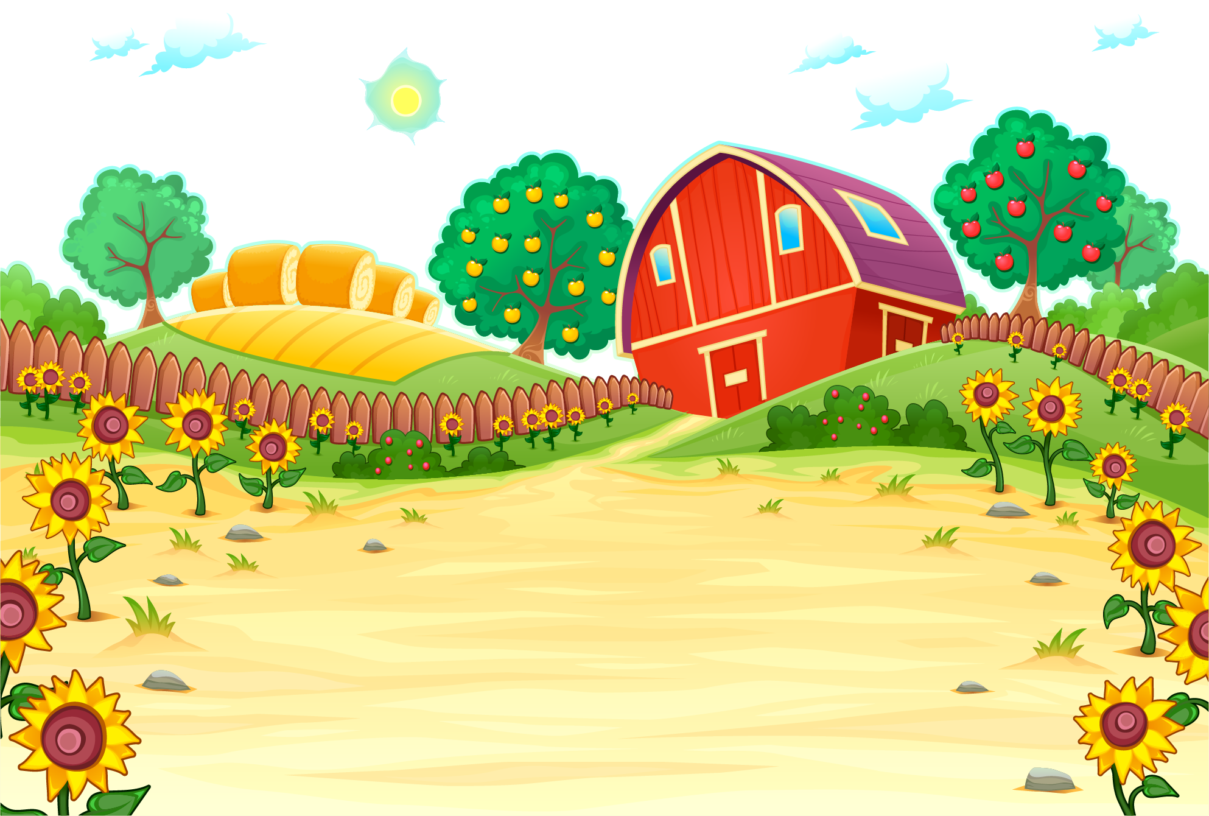
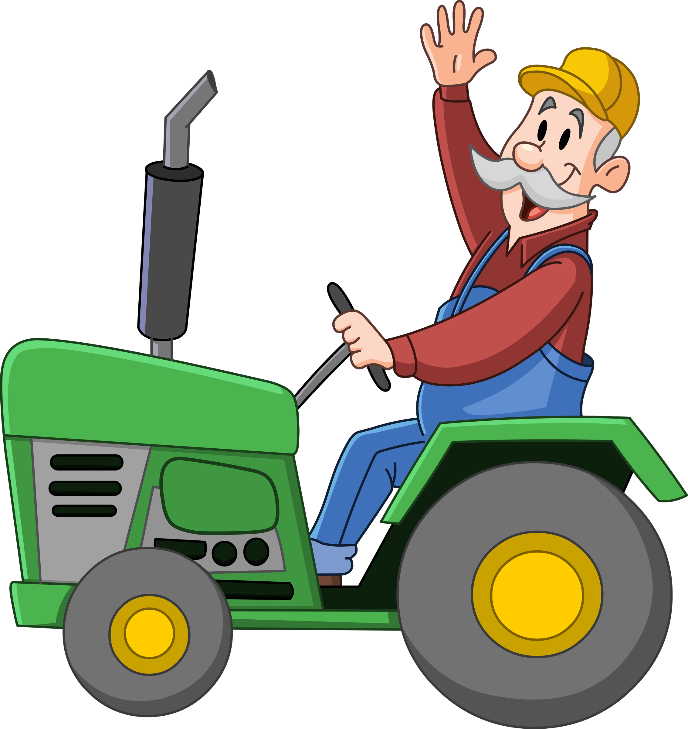


WHEEL
At the farm
RULES
END
GAMES

Slide 3



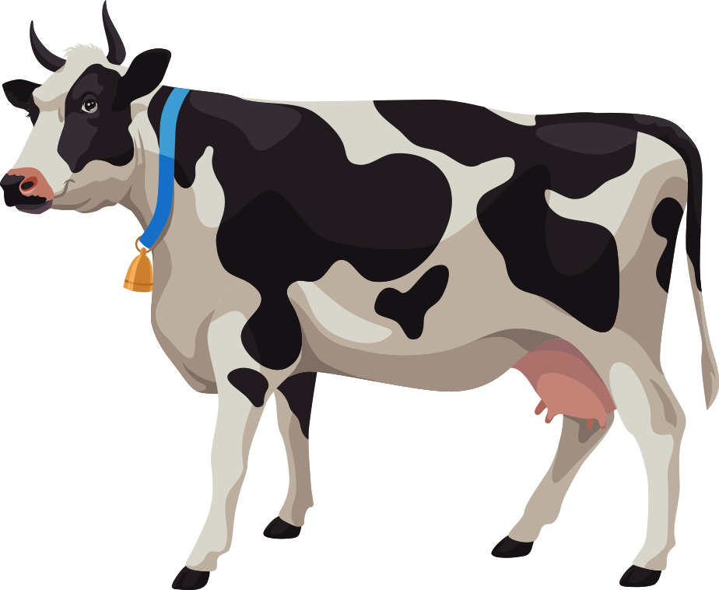




LISTEN
LOOK
SAY
TAP
READ

Slide 4
WHEEL
At the farm
RULES
END
GAMES

Slide 5








What is it?
It is a______.
It is an______.

Slide 6








What can you see?
I see a _____________.

Slide 7

What can you see?
I see a _____________.

Slide 8
I have a _____________.

Slide 9
I have a _____________.

Slide 10
What do you have?
I have a _____________.

Slide 11
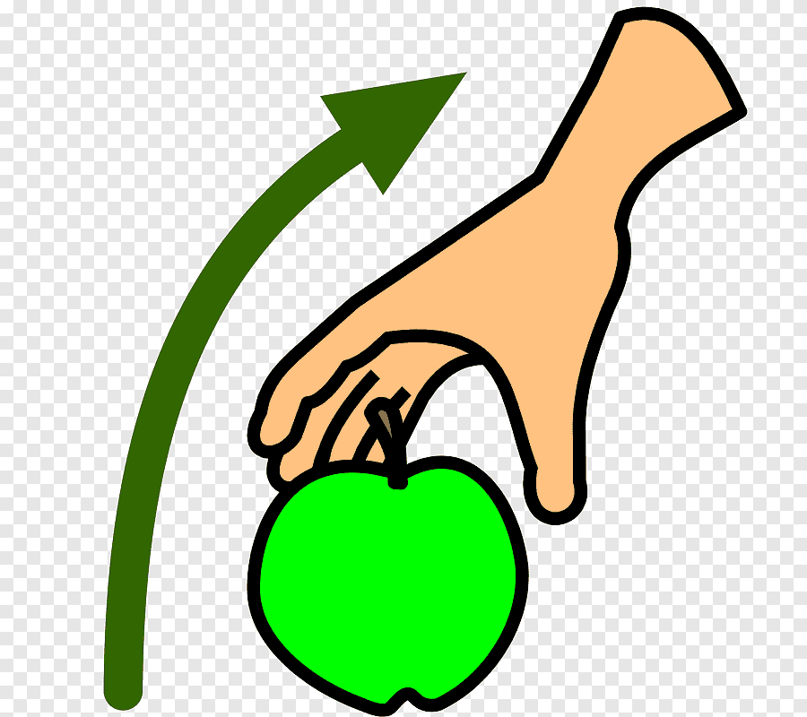

Take a ___
Give me a ________
Thank you.
You are welcome!

Slide 12
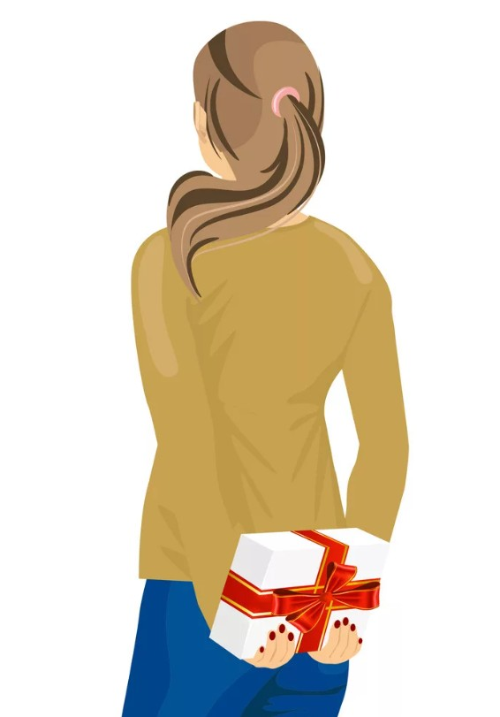
Do you have a green pencil?

Slide 13
Do you have a green pencil?
Yes, I do.
No, I do not.

Slide 14
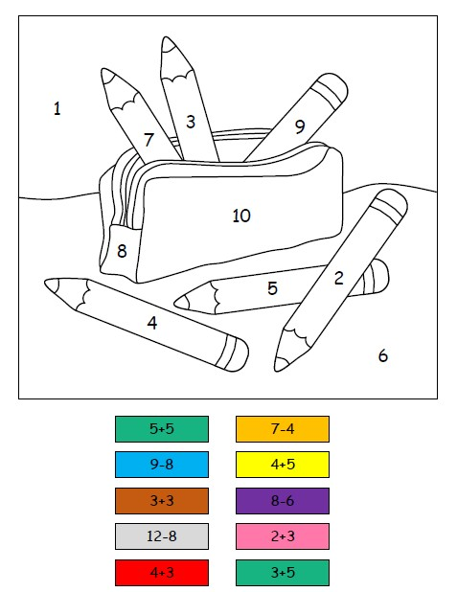
Let’s do math.

Slide 15
WHEEL
At the farm
RULES
END
DEF

Slide 16
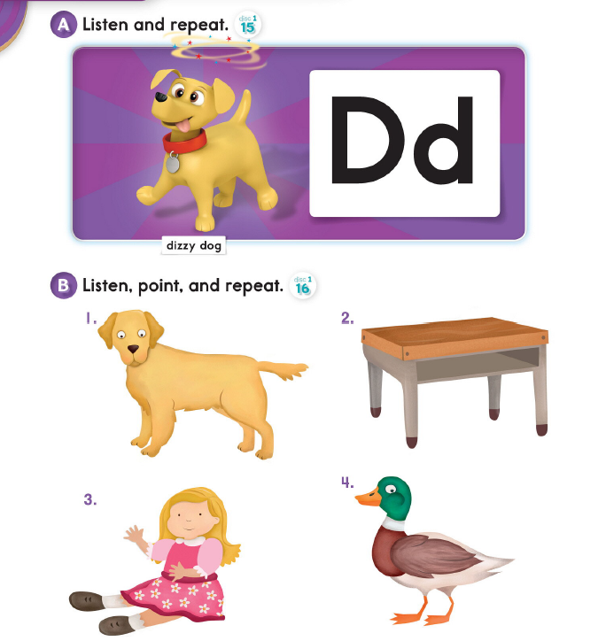
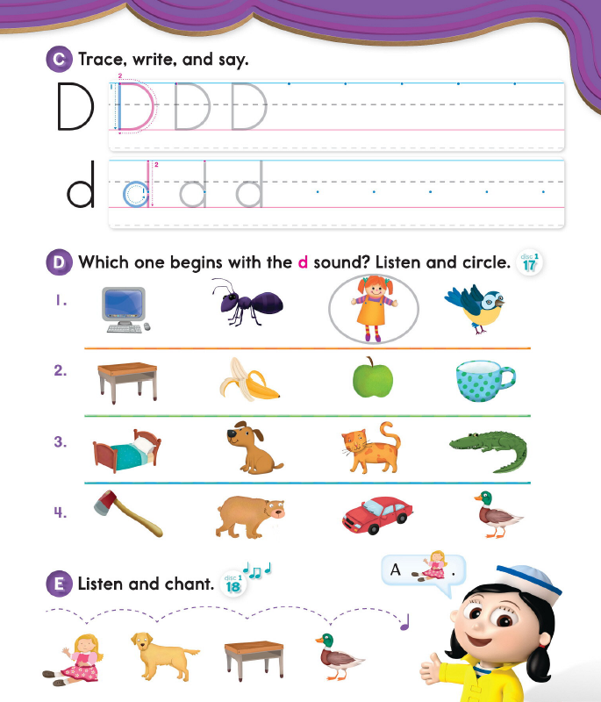

Slide 17
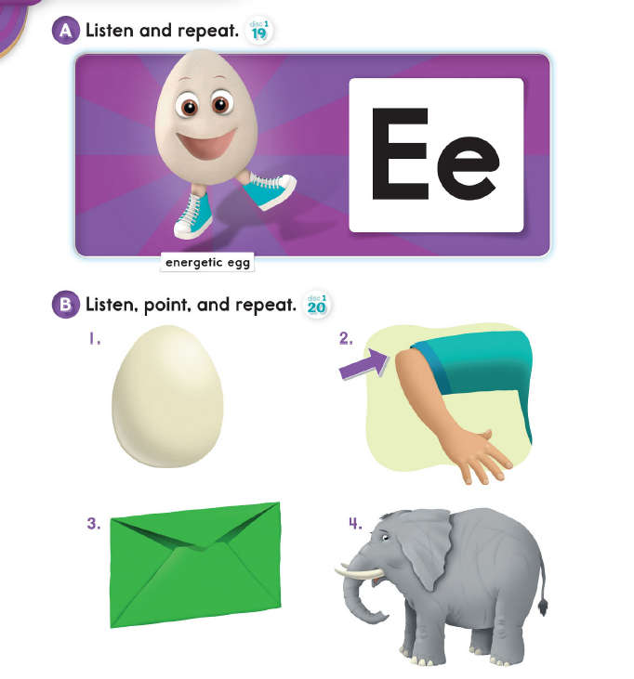
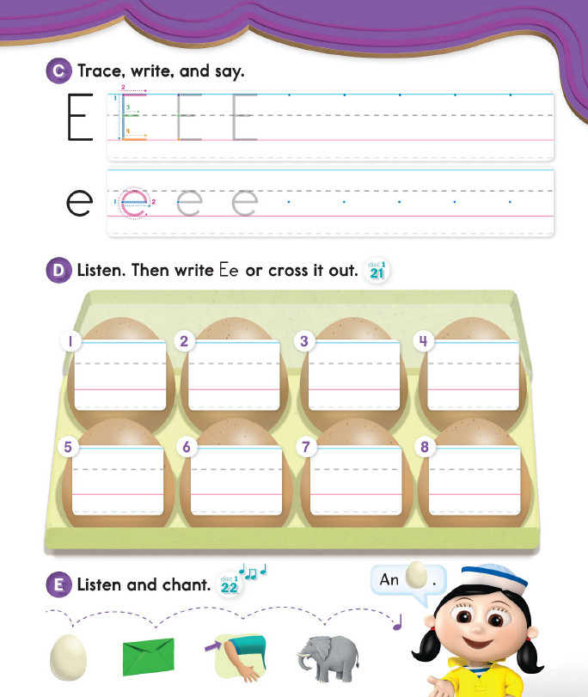

Slide 18
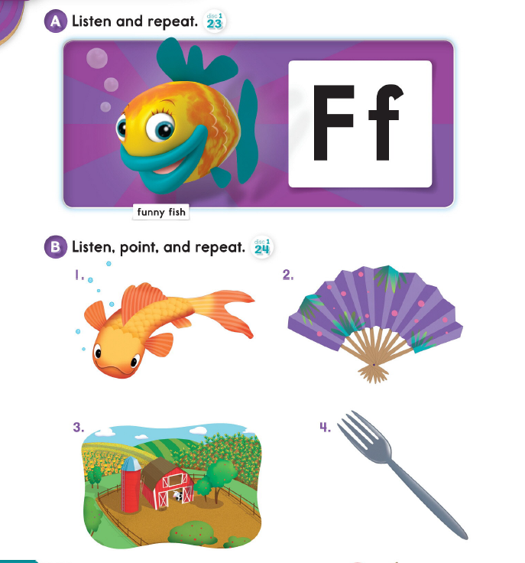
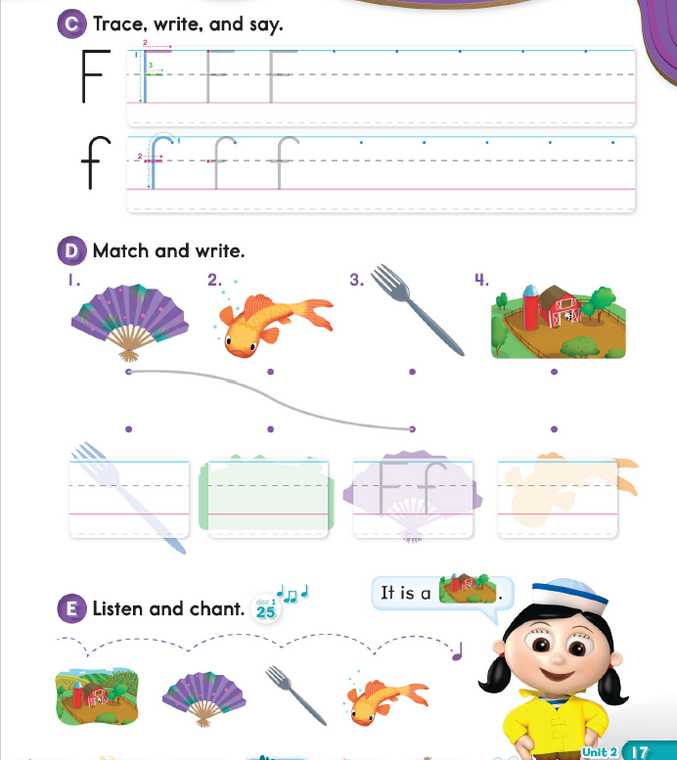

Slide 19
fe ______
de ______
be
ef
ed
ec
eb

Slide 20
WHEEL
At the farm
RULES
END
DEF

